Slide 1

September General
Membership Meeting
Columbia Elementary PTA
Columbia Library/ Zoom Hybrid
9/21/2023

Slide 2
Agenda
Welcome
Standing Rules/Board Introduction
Treasurer’s Report
Events for 2023/2024 School Year
Read-A-Thon
Pajama Jam
Spirit Wear
Fall Book Fair
STEAM Night
Popcorn Fridays
Passive Ways to Financially Support
Ways to be Involved

Slide 3
Standing Rules
Welcome
Standing Rules/
Board Members & Committee Chairs
Treasurer’s Report
Events for 2023/2024 School Year
Read-A-Thon
Pajama Jam
Spirit Wear
Fall Book Fair
STEAM Night
Popcorn Fridays
Passive Ways to Financially Support
Ways to be Involved
Please see our website www.mycolumbiapta.org
BOARD MEMBERS
COMMITTEE CHAIRS
President: Jaime Lewis
Vice President: Rebecca Mork
VP– School Liaison: Ruba Alawar
Secretary: Tran Le
Treasurer: Laura Yengich / Patricia Bai
Art Docent/Poetry By Heart: Tran Le
Spiritwear: Kelly Engelbrecht
Book Fair: Chrissy Klosterman & Amanda Andrus
Reflections: Kristina Bowman
Food for Thought: Karen Siscel-Smith
Teacher Appreciation: Amanda Andrus & ???
Popcorn Friday: ???

Slide 4
Treasurer’s Report: Laura
Welcome
Standing Rules/
Board Members & Chairs
Treasurer’s Report
Events for 2023/2024 School Year
Read-A-Thon
Pajama Jam
Spirit Wear
Fall Book Fair
STEAM Night
Popcorn Fridays
Passive Ways to Financially Support
Ways to be Involved
Current Budget Update
Reminder: Requests that require $$$- get them in early! If we don’t already have money allocated in our budget for an expense, we need to vote on it at a general membership meeting
Grants- will open in November after our fundraiser so we know how much $ we have to give
Teacher’s Wallets
Vote on new Budget Line Item for 2023/2024 – Grade Level Allocation

Slide 5
2023 / 2024 Events: 1st Trimester
Welcome
Standing Rules/
Board Members & Chairs
Treasurer’s Report
Events for 2023/2024 School Year
Read-A-Thon
Pajama Jam
Spirit Wear
Fall Book Fair
STEAM Night
Popcorn Fridays
Passive Ways to Financially Support
Ways to be Involved
9/29 – 10/22 Read-A-Thon Fundraiser
10/7/2023 Outdoor Classroom Clean-Up
10/19/2023 Pajama Jam 6:30pm – 8 pm
  Volunteers needed for Check-In & Concessions
11/13 – 11/17/2023 Book Fair
  Volunteers needed for set-up after school on 11/9/2023 (Thur afternoon)
  Volunteers needed for before school, after school & Tue/Thur evening sales
11/16/2023 STEAM Night
  Volunteers needed for check-in, assist with games/art, concessions?

Slide 6
2023 / 2024 Events : 2nd Trimester
Welcome
Standing Rules/
Board Members & Chairs
Treasurer’s Report
Events for 2023/2024 School Year
Read-A-Thon
Pajama Jam
Spirit Wear
Fall Book Fair
STEAM Night
Popcorn Fridays
Passive Ways to Financially Support
Ways to be Involved
12/5/2023 Dine Out at MOD Pizza
12/14/2023 Winter Teacher Appreciation Event?
1/22 – 1/26/2024 Kindness Week
  Ideas for how PTA can participate?
1/25/2024 Celebrate Diversity Night (to coincide with Kindness Week)
  How can we get more participation? Talent Show?
February & March Art Docent
2/29/2024 Skate Night at Angle of the Winds Arena
3/14/2024 Movie Night (we changed the date since there is no school on the 15th)

Slide 7
2023 / 2024 Events : 3rd Trimester
Welcome
Standing Rules/
Board Members & Chairs
Treasurer’s Report
Events for 2023/2024 School Year
Read-A-Thon
Pajama Jam
Spirit Wear
Fall Book Fair
STEAM Night
Reflections
Passive Ways to Financially Support
Ways to be Involved
Dine Out Night (maybe one in Feb/March @ Tapped again & 1 in May/June at MOD?)
April & May Art Docent
4/22 – 4/26/2024 Spring Book Fair
4/25/2024 Bingo Night
5/1 – 5/3/2024 Poetry By Heart
5/6 – 5/10/2024 Teacher Appreciation Week
5/17/2024 VIP & Me
5/31/2024 Beach Day (or should we have on 6/14 which could be HS graduation day?)

Slide 8
Read-A-THON
Welcome
Standing Rules/
Board Members & Chairs
Treasurer’s Report
Events for 2023/2024 School Year
Read
A
Thon
Pajama Jam
Spirit Wear
Fall Book Fair
STEAM Night
Popcorn Fridays
Passive Ways to Financially Support
Ways to be Involved
Main fundraiser of the year!
Using same company as last year to run the Read-A-Thon
Teachers- best method to hand out prizes to students?
Teachers- sign up everyone in your class (we can merge duplicate accounts if their parents also sign them up) & log class reading minutes!
Community Sponsors

Slide 9
Pajama jam – Thursday, October 19th 6:30 – 8PM
Welcome
Standing Rules/
Board Members & Chairs
Treasurer’s Report
Events for 2023/2024 School Year
Read-A-Thon
Pajama Jam
Spirit Wear
Fall Book Fair
STEAM Night
Popcorn Fridays
Passive Ways to Financially Support
Ways to be Involved
Concessions- we’ll be selling our own concessions this year
  Costco Pizza, Chips/Granola Bars, Water/Soda/Juice
  Must be a PTA Member to handle $$
  Should we hand out something for free? Popcorn or Otter Pops?
  Plan would be to utilize courtyard for concession so we don’t have the back gate open
  If raining, we would have concessions in covered basketball courts & would need to block off access to the fields somehow?
Table at the gym entrance “checking students in” aka- making sure they have adults with them and monitoring for middle-schoolers without adults
Do we need any Key Club volunteers?

Slide 10
SPIRIT WEAR:
Welcome
Standing Rules/
Board Members & Chairs
Treasurer’s Report
Events for 2023/2024 School Year
Read-A-Thon
Pajama Jam
Spirit Wear
Fall Book Fair
STEAM Night
Popcorn Fridays
Passive Ways to Financially Support
Ways to be Involved
Sales period 10/16-10/27
Using same company as last year; updated design
FALL BOOK FAir:
11/13 – 11/17/2023
Set-up will be on a Thursday this year due to Veteran’s Day (will likely need to be after school so we don’t disrupt any library time)
Hosting STEAM night on 11/16/2023 to help boost sales (no overlap in events)
Typically need 4+ volunteers per sales shift; must be a PTA member to handle $$

Slide 11
STEAM NIGHT:
Welcome
Standing Rules/
Board Members & Chairs
Treasurer’s Report
Events for 2023/2024 School Year
Read-A-Thon
Pajama Jam
Spirit Wear
Fall Book Fair
STEAM Night
Popcorn Fridays
Passive Ways to Financially Support
Ways to be Involved
Thursday, 11/16/2023 6:30pm-8pm
Snohomish PUD & Mathnasium sign-up to participate
Reflections art station? This year's theme is "I am Hopeful Because…“
What other activities should we have?
Concessions?
Key Club Volunteers
More info about Reflections
WSPTA art recognition program. Reflections is an art contest that encourages creativity in these six categories: dance choreography, film production, literature, music composition, photography and visual arts. This year's theme is "I am Hopeful Because…“
Reflections entries will be due at End of November; PTA volunteers will judge the entries and select one primary & one intermediate entry to submit to WSPTA

Slide 12
Popcorn fridays:
Welcome
Standing Rules/
Board Members & Chairs
Treasurer’s Report
Events for 2023/2024 School Year
Read-A-Thon
Pajama Jam
Spirit Wear
Fall Book Fair
STEAM Night
Popcorn Fridays
Passive Ways to Financially Support
Ways to be Involved
How should we manage this with Running Club Fridays?
Amanda Andrus has volunteered to be Popcorn Friday coordinator; anyone want to help?
Tentative dates:
  9/30/2023 (or wait until October to start these up?)
  10/27/2023
  12/1/2023
  1/26/2024
  3/1/2024
  4/5/2024
  5/3/2024
  6/14/2024 (maybe Popsicle Friday)

Slide 13
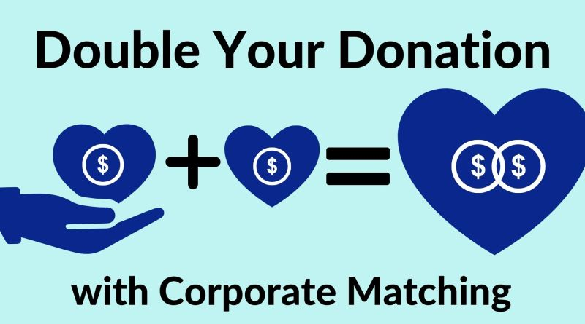

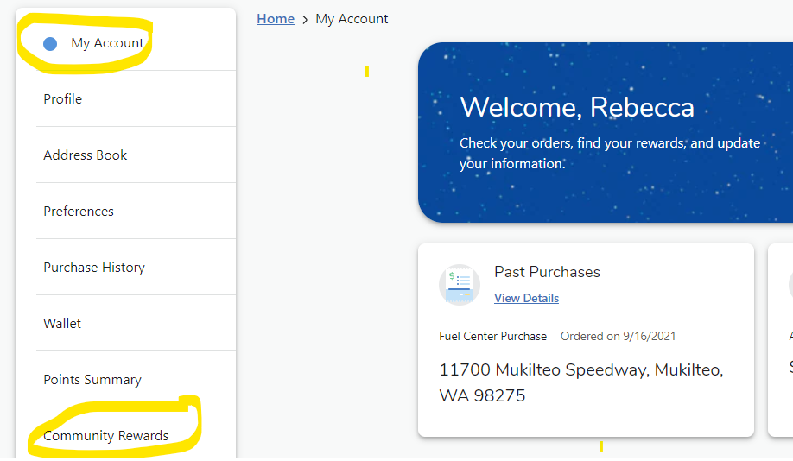
Passive Ways for Support
Welcome
Standing Rules/
Board Members & Chairs
Treasurer’s Report
Events for 2023/2024 School Year
Read-A-Thon
Pajama Jam
Spirit Wear
Fall Book Fair
STEAM Night
Popcorn Fridays
Passive Ways to Financially Support
Ways to be Involved
Corporate Match
Box Tops
Fred Meyer Rewards

Slide 14

Please sign in on the sign-in sheet
Welcome
Standing Rules/
Board Members & Chairs
Treasurer’s Report
Events for 2023/2024 School Year
Read-A-Thon
Pajama Jam
Spirit Wear
Fall Book Fair
STEAM Night
Popcorn Fridays
Passive Ways to Financially Support
Ways to be Involved
You don’t have to be a PTA member to volunteer; remember to sign up as a volunteer thru MSD.
We will take what you can give. You can give what you want. There is a role for everyone.
Looking for more involvement? We’re looking for the following:
Popcorn Friday Committee
Teacher Appreciation Committee

