Slide 1

OCTOBER General
Membership Meeting
Columbia Elementary PTA
Columbia Library/ Zoom Hybrid
10/26/2023

Slide 2
Agenda
Welcome
Standing Rules / Board Members / Committee Chairs
Treasurer’s Report
Events for 2023/2024 School Year
Read-A-Thon Update
Pajama Jam Update
Spirit Wear
Fall Book Fair
STEAM Night
Passive Ways to Financially Support
Ways to be Involved
Popcorn Monday

Slide 3
Standing Rules
Welcome
Standing Rules/
Board Members & Committee Chairs
Treasurer’s Report
Events for 2023/2024 School Year
Read-A-Thon
Pajama Jam
Spirit Wear
Fall Book Fair
STEAM Night
Popcorn Monday
Passive Ways to Financially Support
Ways to be Involved
Please see our website www.mycolumbiapta.org
BOARD MEMBERS
COMMITTEE CHAIRS
President: Jaime Lewis
Vice President: Rebecca Mork
VP– School Liaison: Ruba Alawar
Secretary: Tran Le
Treasurer: Laura Yengich / Patricia Bai
Art Docent/Poetry By Heart: Tran Le
Spiritwear: Kelly Engelbrecht
Book Fair: Chrissy Klosterman & Amanda Andrus
Reflections: Kristina Bowman
Food for Thought: Karen Siscel-Smith
Teacher Appreciation: Amanda Andrus & Patricia Bai
Popcorn Monday: Amanda Andrus

Slide 4
Treasurer’s Report: Laura
Welcome
Standing Rules/
Board Members & Chairs
Treasurer’s Report
Events for 2023/2024 School Year
Read-A-Thon
Pajama Jam
Spirit Wear
Fall Book Fair
STEAM Night
Popcorn Monday
Passive Ways to Financially Support
Ways to be Involved
Current Budget Update
Grants will open in November
Budget Re-Allocation
  Vote to re-allocate $500 from Pajama Jam to Celebrate Diversity Night (If this is approved we can try to get Imagine Children’s Museum to bring their Family Engagement Program “Celebrate Our World” (if approved total budget would be $600)
  Vote to re-allocate $250 from Pajama Jam to Kindness Week (if approved total budget would be $500)
General School Improvement Fund- Kelli’s request (cones, etc?)

Slide 5
2023 Events
Welcome
Standing Rules/
Board Members & Chairs
Treasurer’s Report
Events for 2023/2024 School Year
Read-A-Thon
Pajama Jam
Spirit Wear
Fall Book Fair
STEAM Night
Popcorn Monday
Passive Ways to Financially Support
Ways to be Involved
10/30/2023 Popcorn Monday
11/13 – 11/17/2023 Book Fair
  Volunteers needed for set-up after school on 11/9/2023 (Thur afternoon)
  Volunteers needed for library times, after school & Tue/Thur evening sales
11/16/2023 STEAM Night
  Volunteers needed for check-in, assist with games/art, concessions
11/30/2023 PTA Membership Meeting (7pm – Zoom)
12/5/2023 Dine Out at MOD Pizza
12/11/2023 Potential Popcorn Monday
12/14/2023 Winter Teacher Appreciation Lunch (soup/salad bar?)

Slide 6
2024 Events
Welcome
Standing Rules/
Board Members & Chairs
Treasurer’s Report
Events for 2023/2024 School Year
Read-A-Thon
Pajama Jam
Spirit Wear
Fall Book Fair
STEAM Night
Popcorn Monday
Passive Ways to Financially Support
Ways to be Involved
1/22 – 1/26/2024 Kindness Week (Patricia & Tran to work with Ms. Lee)
1/25/2024 Celebrate Diversity Night (to coincide with Kindness Week)
  If budget re-allocation approved try to get Imagine Children’s Museum Family Engagement Program “Celebrate Our World”
February – May Art Docent
2/29/2024 Skate Night at Angle of the Winds Arena
3/14/2024 Movie Night
4/22 – 4/26/2024 Spring Book Fair
4/25/2024 Bingo Night
4/29 – 5/3/2024 Poetry By Heart
5/6 – 5/10/2024 Teacher Appreciation Week
5/17/2024 VIP & Me (offer 2 Fridays so we can open it up to more people?)
5/31/2024 Beach Day (or should we have on 6/14 which could be HS graduation day?)
Dine Out Night (maybe one in Feb/March @ Diamond Knot & 1 in May/June at Brooklyn Brothers Pizza?)

Slide 7
Read-A-THON UPDATE
Welcome
Standing Rules/
Board Members & Chairs
Treasurer’s Report
Events for 2023/2024 School Year
Read
A
Thon
Pajama Jam
Spirit Wear
Fall Book Fair
STEAM Night
Popcorn Monday
Passive Ways to Financially Support
Ways to be Involved
Thank you to our Community Sponsors: Chaison Orthdontics, New West Development, Stellar Kids Dental, Mathnasium of Mukilteo, Miller’s Rent-All, Kids Photography & Mukilteo Chocolate Company
We raised $28,266.50; we should bring in ~$26k before the cost of our prizes
Schedule parties for the winning classes:
  Minaker & Roberts- flashlight reading party with treats
  Roberson/Baird- PE Star Wars game and Pizza Party
  Mebly- Gaga Ball Pit Grand Opening & Pizza Party
Schedule popsicles at recess since school met reading goal
Continue handing out prizes as we receive them

Slide 8
Pajama jam UPDATE
Welcome
Standing Rules/
Board Members & Chairs
Treasurer’s Report
Events for 2023/2024 School Year
Read-A-Thon
Pajama Jam
Spirit Wear
Fall Book Fair
STEAM Night
Popcorn Monday
Passive Ways to Financially Support
Ways to be Involved
Feedback from Teachers or Staff who attended?
Key Club volunteers were great!
Turned an event that had $1000 budget into a break-even event by selling our own concessions

Slide 9
SPIRIT WEAR:
Welcome
Standing Rules/
Board Members & Chairs
Treasurer’s Report
Events for 2023/2024 School Year
Read-A-Thon
Pajama Jam
Spirit Wear
Fall Book Fair
STEAM Night
Popcorn Monday
Passive Ways to Financially Support
Ways to be Involved
Sale end tomorrow (10/27/2023)
Rebecca is working on gathering info for PTA order for Read-A-Thon fundraiser prizes
FALL BOOK FAir:
11/13 – 11/17/2023
Set-up will be on a Thursday this year due to Veteran’s Day
Hosting STEAM night on 11/16/2023 to help boost sales (no overlap in events)
Volunteers must be a PTA member to handle $$
No before school sales; library time and after school sales only

Slide 10
STEAM NIGHT:
Welcome
Standing Rules/
Board Members & Chairs
Treasurer’s Report
Events for 2023/2024 School Year
Read-A-Thon
Pajama Jam
Spirit Wear
Fall Book Fair
STEAM Night /
Reflections
Popcorn Monday
Passive Ways to Financially Support
Ways to be Involved
Thursday, 11/16/2023 6:30pm-8pm
Stations:
  Snohomish PUD: Track Wildlife like a PUD biologist
  Mathnasium: math games
  Jaime: Snap Circuits & Brain Flakes
  Kristina/Tran: Reflections art station
Concessions? Or Free snacks with a donation jar?
Key Club Volunteers (all 12 slots are filled)
Our school’s Submission Deadline is Monday, November 27th
WSPTA Reflections art contest:

Slide 11
Popcorn Monday:
Welcome
Standing Rules/
Board Members & Chairs
Treasurer’s Report
Events for 2023/2024 School Year
Read-A-Thon
Pajama Jam
Spirit Wear
Fall Book Fair
STEAM Night
Popcorn Monday
Passive Ways to Financially Support
Ways to be Involved
Amanda Andrus has volunteered to be Popcorn coordinator
Trial Monday on 10/30/2023
Tentative remaining dates if all goes well on Monday:
  12/11/2023
  1/29/2024
  2/26/2024
  3/25/2024
  4/29/2024
  5/20/2024

Slide 12


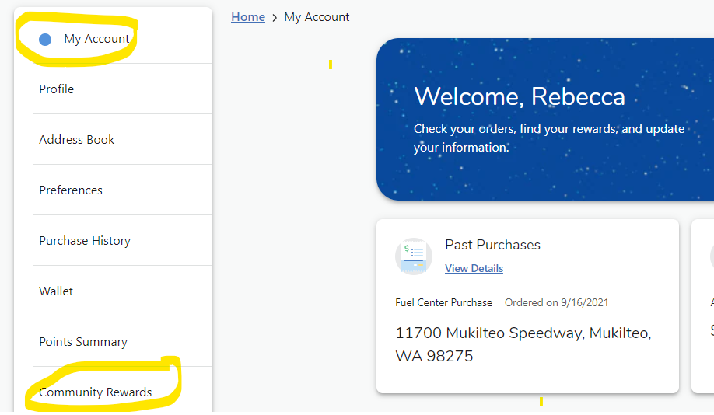
Passive Ways for Support
Welcome
Standing Rules/
Board Members & Chairs
Treasurer’s Report
Events for 2023/2024 School Year
Read-A-Thon
Pajama Jam
Spirit Wear
Fall Book Fair
STEAM Night
Popcorn Monday
Passive Ways to Financially Support
Ways to be Involved
Corporate Match
Box Tops
Fred Meyer Rewards

Slide 13

Please sign in on the sign-in sheet
Welcome
Standing Rules/
Board Members & Chairs
Treasurer’s Report
Events for 2023/2024 School Year
Read-A-Thon
Pajama Jam
Spirit Wear
Fall Book Fair
STEAM Night
Popcorn Monday
Passive Ways to Financially Support
Ways to be Involved
You don’t have to be a PTA member to volunteer; remember to sign up as a volunteer thru MSD.
We will take what you can give. You can give what you want. There is a role for everyone.
Next General Membership Meeting:
  Thursday, 11/30/2023 at 7pm (Zoom)

