Slide 1

November General
Membership Meeting
Columbia Elementary PTA
Zoom
11/30/2023

Slide 2
Agenda
Welcome
Standing Rules / Board Members / Committee Chairs
Treasurer’s Report
Past Events
December Events
Passive Ways to Financially Support
Ways to be Involved
Diversity Night
Remaining Events

Slide 3
Standing Rules
Welcome
Standing Rules/
Board Members & Committee Chairs
Treasurer’s Report
Past Events
December Events
Diversity Night
Passive Ways to Financially Support
Ways to be Involved
Remaining Events
Please see our website www.mycolumbiapta.org
BOARD MEMBERS
COMMITTEE CHAIRS
President: Jaime Lewis
Vice President: Rebecca Mork
VP– School Liaison: Ruba Alawar
Secretary: Tran Le
Treasurer: Laura Yengich / Patricia Bai
Art Docent/Poetry By Heart: Tran Le
Spiritwear: Kelly Engelbrecht
Book Fair: Chrissy Klosterman & Amanda Andrus
Reflections: Kristina Bowman
Food for Thought: Karen Siscel-Smith
Teacher Appreciation: Amanda Andrus & Patricia Bai
Popcorn Monday: Amanda Andrus

Slide 4
Treasurer’s Report:
Welcome
Standing Rules/
Board Members & Chairs
Treasurer’s Report
Past Events
December Events
Diversity Night
Passive Ways to Financially Support
Ways to be Involved
Remaining Events
Current Budget Update
Grants

Slide 5
Past Events updates:
Welcome
Standing Rules/
Board Members & Chairs
Treasurer’s Report
Past
Events
December Events
Diversity Night
Passive Ways to Financially Support
Ways to be Involved
Remaining Events
Read-A-Thon:
  Schedule parties for the winning classes
  Schedule popsicles at recess since school met reading goal
  Continue handing out prizes as we receive them
Spirit Wear: handed out this week; any issues must be identified by 12/8/23
Fall Book Fair: over $12k in sales (over $6k in Scholastic dollars for library)
STEAM Night:
  Feedback?

Slide 6
December events:
Welcome
Standing Rules/
Board Members & Chairs
Treasurer’s Report
Past Events
December Events
Passive Ways to Financially Support
Ways to be Involved
Diversity Night
Remaining Events
12/5/2023 Dine Out at MOD Pizza
12/11/2023 Popcorn Monday
12/14/2023 Winter Teacher Appreciation Lunch (soup/salad bar?)
  Stay tuned for Sign-Up Genius
  $500 budget to supplement donated goods
Reflections Art Contest Judging

Slide 7
Diversity night:
Welcome
Standing Rules/
Board Members & Chairs
Treasurer’s Report
Past Events
December Events
Diversity Night
Passive Ways to Financially Support
Ways to be Involved
Remaining Events
Imagine Children’s Museum Family Engagement Program “Celebrate Our World”
  Families travel the world to discover traditions, play games and make crafts from other countries.
  Includes 10 hands-on activity stations; we need to provide 1 volunteer per station
Key Club Volunteers (Jaime will request)
Other booths?
Snacks?

Slide 8
2024 Events:
Welcome
Standing Rules/
Board Members & Chairs
Treasurer’s Report
Remaining Events
Passive Ways to Financially Support
Ways to be Involved
Past Events
December Events
Diversity Night
1/18/2024 General Membership Meeting (3:45pm Library)
1/22 – 1/26/2024 Kindness Week (Patricia & Tran to work with Ms. Lee)
1/26/2024 Celebrate Diversity Night (to coincide with Kindness Week) *** Date Changed***
1/29/2024 Popcorn Monday

Slide 9
2024 Events:
Welcome
Standing Rules/
Board Members & Chairs
Treasurer’s Report
Remaining Events
Passive Ways to Financially Support
Ways to be Involved
Past Events
December Events
Diversity Night
February – Art Docent
2/15/2024 General Membership Meeting (3:45pm Library)
2/26/2024 Popcorn Monday
2/29/2024 Skate Night at Angle of the Winds Arena
Dine Out Night (maybe one in Feb/March @ Diamond Knot or Brooklyn Bros.)
March – Art Docent
3/14/2024 Movie Night
3/21/2024 General Membership Meeting (7pm Zoom)
3/25/2024 Popcorn Monday

Slide 10
2024 Events:
Welcome
Standing Rules/
Board Members & Chairs
Treasurer’s Report
Remaining Events
Passive Ways to Financially Support
Ways to be Involved
Past Events
December Events
Diversity Night
April – Art Docent
4/18/2024 General Membership Meeting (3:45pm Library)
4/19/2024 Set up for Spring Book Fair
4/22 – 4/26/2024 Spring Book Fair
4/25/2024 Bingo Night (Volunteers to help coordinate???)
4/29/2024 Popcorn Monday
4/29 – 5/3/2024 Poetry By Heart
Schedule an After-School Gaga Ball Pit Party for 2023 graduates?

Slide 11
2024 Events:
Welcome
Standing Rules/
Board Members & Chairs
Treasurer’s Report
Remaining Events
Passive Ways to Financially Support
Ways to be Involved
Past Events
December Events
Diversity Night
May – Art Docent
5/6 – 5/10/2024 Teacher Appreciation Week
5/16/2024 General Membership Meeting (7pm Zoom)
5/17/2024 VIP & Me (offer 2 Fridays so we can open it up to more people?)
5/20/2024 Popcorn Monday
5/31/2024 Beach Day (need volunteers to help coordinate)
Dine Out Night (maybe one in May/June @ Diamond Knot or Brooklyn Bros?)
6/17/2024 Final Popcorn Monday (or Popsicle Monday)

Slide 12
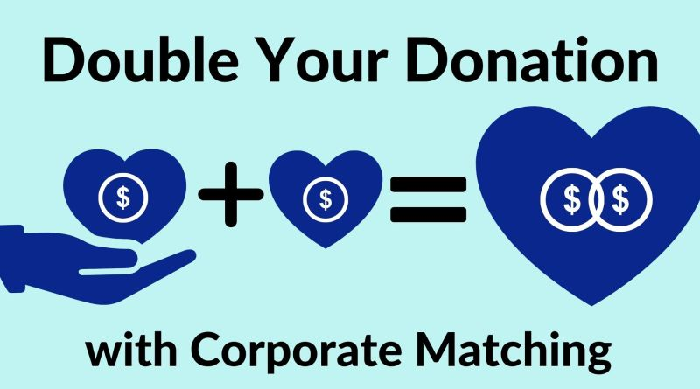

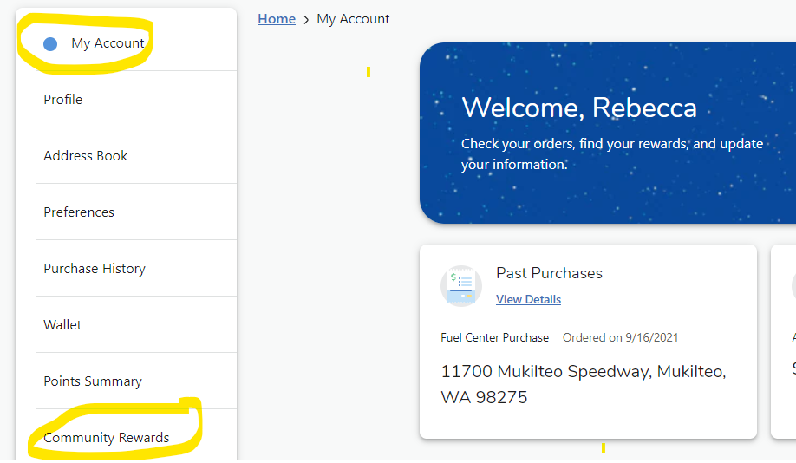
Passive Ways for Support
Welcome
Standing Rules/
Board Members & Chairs
Treasurer’s Report
Past Events
December Events
Diversity Night
Passive Ways to Financially Support
Ways to be Involved
Remaining Events
Corporate Match
Box Tops
Fred Meyer Rewards

Slide 13

Please sign in on the sign-in sheet
Welcome
Standing Rules/
Board Members & Chairs
Treasurer’s Report
Past Events
December Events
Diversity Night
Passive Ways to Financially Support
Ways to be Involved
Remaining Events
You don’t have to be a PTA member to volunteer; remember to sign up as a volunteer thru MSD.
We will take what you can give. You can give what you want. There is a role for everyone.
Next General Membership Meeting:
  Thursday, 1/18/2024 at 3:45pm

