Slide 1

MAY General
Membership Meeting
Columbia Elementary PTA
7PM on Zoom
5/16/2024

Slide 2
Standing Rules
Welcome
Standing Rules/
Board Members & Committee Chairs
Treasurer’s Report
Past Events
Upcoming
Events
Beach Day
Ways to be Involved
Volunteer Appreciation
Please see our website www.mycolumbiapta.org
BOARD MEMBERS
COMMITTEE CHAIRS
President: Jaime Lewis
Vice President: Rebecca Mork
VP– School Liaison: Ruba Alawar
Secretary: Tran Le
Treasurer: Laura Yengich / Patricia Bai
Art Docent/Poetry By Heart: Tran Le
Spiritwear: Kelly Engelbrecht
Book Fair: Chrissy Klosterman & Amanda Andrus
Reflections: Kristina Bowman
Food for Thought: Karen Siscel-Smith
Teacher Appreciation: Amanda Andrus & Patricia Bai
Popcorn Monday: Kelly Engelbrecht

Slide 3
Welcome
Standing Rules/
Board Members & Committee Chairs
Treasurer’s Report
Past Events
Upcoming
Events
Beach Day
Ways to be Involved
Volunteer Appreciation
2024-2025 Positions
BOARD MEMBERS
COMMITTEE CHAIRS
President: Jaime Lewis
Vice President: Patricia Bai
VP– School Liaison: Ruba Alawar
Secretary: Tran Le
Treasurer: __________/ Laura Yengich
Fundraising: ______________
Art Docent: Ashley Johnson / Tran Le
Poetry By Heart: Tran Le
Spiritwear: Kelly Engelbrecht
Book Fair: Chrissy Klosterman & Lesley Martinell
Reflections: Kristina Bowman
Food for Thought: Karen Siscel-Smith
Teacher Appreciation: Patricia Bai & Trang Phan
Popcorn Monday: Kelly Engelbrecht
Vote to approve & install 2024 – 2025 Board

Slide 4
Treasurer’s Report:
Welcome
Standing Rules/
Board Members & Chairs
Treasurer’s Report
Past Events
Upcoming
Events
Beach Day
Ways to be Involved
Volunteer Appreciation
Current Budget Update
2024-2025 Budget approved in April meeting
2024-2025 Fundraiser
  WA State PTA Membership Management vendor is changing from Member Planet to Givebacks starting July 2024 (for next school year)
  Givebacks has a platform for fundraising already built into the site; fees look comparable to GetMovin FundHub (maybe even a little lower) and it will track prize earnings based on reading minutes (not just $ raised) which is better than FundHub.
  Givebacks also has a Store option that will allow us to sell other merchandise through them (ie- Columbia Cougar socks)
Reader Board status

Slide 5
Past Events updates:
Welcome
Standing Rules/
Board Members & Chairs
Treasurer’s Report
Past
Events
Upcoming
Events
Beach Day
Ways to be Involved
Volunteer Appreciation
Bingo Night
Spring Book Fair
Poetry-By-Heart
Art Docent
Teacher Appreciation
Any feedback on past events?

Slide 6
UPCOMING events:
Welcome
Standing Rules/
Board Members & Chairs
Treasurer’s Report
Past Events
Upcoming
Events
Ways to be Involved
Beach Day
Volunteer Appreciation
Donuts with Grownups – Friday (tomorrow) from 4 – 5pm
  Current RSVP count
Popsicle Monday – Monday, June 17th?
UPCOMING NON-PTA events:
5th Grade Camp
5th Grade Celebration

Slide 7
Beach day – Friday, may 31st 4 – 7pm
Welcome
Standing Rules/
Board Members & Chairs
Treasurer’s Report
Past Events
Upcoming Events
Beach Day
Ways to be Involved
Volunteer Appreciation
Shelters are reserved all day so we can set-up any time
Food:
  PTA purchasing Cake & Sandwiches
  Sign-Up Genius is live for people to sign up for chips, fruit & drinks (and to volunteer to help!)
  Otter pops?
Activities:
  Temporary tattoos?
  Lawn Games? Hula Hoops, bubbles
  Volleyball for courts
Paper flyer?
RSVP is active
Backup plan for rain?

Slide 8
We want to recognize the following volunteers who helped make events happen!
Welcome
Standing Rules/
Board Members & Chairs
Treasurer’s Report
Volunteer Appreciation
Ways to be Involved
Past Events
Upcoming
Events
Beach Day
Fundraising: Rebecca Mork- we’ll miss seeing you and your kids around Columbia!
Art Docent & Poetry By Heart: Tran Le
Spiritwear: Kelly Engelbrecht
Book Fair: Amanda Andrus, Chrissy Klosterman, Laura Yengich & Marcie Lyle
Reflections: Kristina Bowman
Food for Thought: Karen Siscel-Smith
Teacher Appreciation: Amanda Andrus, Patricia Bai & Trang Phan
Popcorn Monday: Amanda Andrus, Kelly Engelbrecht, Trang Phan, Patricia Bai, Jean Smoke, Angelica Anderson, Rachelle Brown
Events: Ruba Alawar, Christina Gilmore, Ashley Johnson, Jenny Berke, Michelle Gunther, Heidi Hagan, Angelica Anderson, Kristin Harrison, Patricia Bai, Tran Le, Laura Yengich…
I am sure that I missed some people…but thank you to everyone who consistently shows up to volunteer at our events!
Thank you for gifting your time and energy!

Slide 9
Early Planning for 2024-2025 School Year
Welcome
Standing Rules/
Board Members & Chairs
Treasurer’s Report
Past Events
Upcoming Events
Beach Day
Ways to be Involved
Volunteer Appreciation
Kindergarten Camp (August)
District Back to School Fair (August)
Popsicles on the Playground (September)
Membership Drive (September)
Pajama Jam (October)
Fundraiser- Read-A-Thon (October)
Book Fair (November)
STEAM Night (November- coincide with Book Fair)
Multi-Cultural Night (January)
Skate Night (February)
Movie Night (March)
Book Fair (April)
Bingo Night (April – coincide with Book Fair)
Poetry By Heart (May)
Teacher Appreciation (May)
VIP & Me (May)
Beach Day (June)

Slide 10

Welcome
Standing Rules/
Board Members & Chairs
Treasurer’s Report
Past Events
Upcoming Events
Beach Day
Ways to be Involved
Volunteer Appreciation
Need Volunteers for:
2024-2025 Board Treasurer (or President)
2024-2025 Fundraising Committee
We will take what you can give. You can give what you want. There is a role for everyone.
You don’t have to be a PTA member to volunteer; remember to sign up as a volunteer thru MSD.
Next Meeting – September 2024!

Slide 11
Agenda
Welcome
Standing Rules / Board Members / Committee Chairs
Treasurer’s Report
Past Events
February Events
Ways to be Involved
Movie Night
Remaining Events

Slide 12


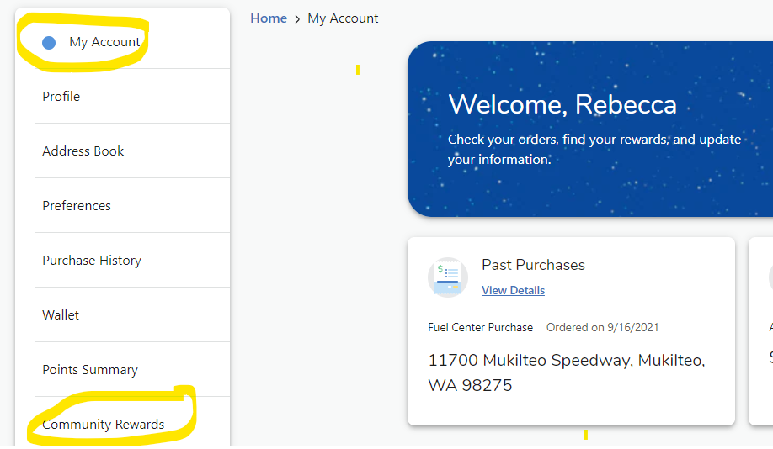
Passive Ways for Support
Welcome
Standing Rules/
Board Members & Chairs
Treasurer’s Report
Past Events
January Events
Skate Night & Movie Night
Passive Ways to Financially Support
Ways to be Involved
Remaining Events
Corporate Match
Box Tops
Fred Meyer Rewards

