Slide 1

January General
Membership Meeting
Columbia Elementary PTA
3:45pm Columbia Elementary Library
01/18/2024

Slide 2
Standing Rules
Welcome
Standing Rules/
Board Members & Committee Chairs
Treasurer’s Report
Past Events
January Events
Skate Night & Movie Night
Ways to be Involved
Remaining Events
Please see our website www.mycolumbiapta.org
BOARD MEMBERS
COMMITTEE CHAIRS
President: Jaime Lewis
Vice President: Rebecca Mork
VP– School Liaison: Ruba Alawar
Secretary: Tran Le
Treasurer: Laura Yengich / Patricia Bai
Art Docent/Poetry By Heart: Tran Le
Spiritwear: Kelly Engelbrecht
Book Fair: Chrissy Klosterman & Amanda Andrus
Reflections: Kristina Bowman
Food for Thought: Karen Siscel-Smith
Teacher Appreciation: Amanda Andrus & Patricia Bai
Popcorn Monday: Amanda Andrus

Slide 3
Treasurer’s Report:
Welcome
Standing Rules/
Board Members & Chairs
Treasurer’s Report
Past Events
January Events
Skate Night & Movie Night
Ways to be Involved
Remaining Events
Current Budget Update
Grants
Skate Night Budget:
  Should we charge $5/skater admission?
  Vote to add a Budget Line for Skate Night
    Budget of ~$900 if we don’t charge admission
    Budget of ~$450 if we do charge admission

Slide 4
Past Events updates:
Welcome
Standing Rules/
Board Members & Chairs
Treasurer’s Report
Past
Events
January Events
Skate Night & Movie Night
Ways to be Involved
Remaining Events
Still need to hand out popsicles for Read-A-Thon reward…waiting for better weather
Winter Break Bingo – need to hand out prizes
Reflections Update
Any Feedback on past events?

Slide 5
JANUARY events:
Welcome
Standing Rules/
Board Members & Chairs
Treasurer’s Report
Past Events
January
Events
Ways to be Involved
Skate Night & Movie Night
Remaining Events
Kindness Week (1/22 – 1/26/2024)
  We need a few more volunteers to assist with card making stations on Tues & Wed
Multi-Cultural Night:
  Imagine Children’s Museum Family Engagement Program “Celebrate Our World”
  Key Club Volunteers (sign-ups are full)
  Should we have snacks? Concessions sales or free snacks?
Popcorn Monday: 1/29/2024
  We need a few more volunteers to help with this event

Slide 6
Skate night: 2/29/2024
Movie night: 3/14/2024
Welcome
Standing Rules/
Board Members & Chairs
Treasurer’s Report
Past Events
January Events
Skate Night & Movie Night
Ways to be Involved
Remaining Events
Skate Night at Angle of the Winds Arena
Tran will create a pre-registration form
Anything else we need to do?
Movie?
No cost for admission
Snacks for sale (popcorn for free again?)
See if we can get donated popcorn from AMC or Regal?

Slide 7
2024 Events:
Welcome
Standing Rules/
Board Members & Chairs
Treasurer’s Report
Remaining Events
Ways to be Involved
Past Events
January Events
Skate Night & Movie Night
February – May Art Docent (still have a few classes that need parent volunteers)
2/15/2024 General Membership Meeting (3:45pm Library)
2/26/2024 Popcorn Monday
2/29/2024 Skate Night at Angle of the Winds Arena
Dine Out Night (maybe one in Feb/March @ Diamond Knot or Brooklyn Bros.)
3/11 – 3/15 Support Professionals Appreciation Week
3/14/2024 Movie Night
3/21/2024 General Membership Meeting (7pm Zoom)
3/25/2024 Popcorn Monday

Slide 8
2024 Events:
Welcome
Standing Rules/
Board Members & Chairs
Treasurer’s Report
Remaining Events
Ways to be Involved
Past Events
January Events
Skate Night & Movie Night
4/18/2024 General Membership Meeting (3:45pm Library)
4/19/2024 Set up for Spring Book Fair
4/22 – 4/26/2024 Spring Book Fair
4/25/2024 Bingo Night
4/29/2024 Popcorn Monday
4/29 – 5/3/2024 Poetry By Heart
5/6 – 5/10/2024 Teacher Appreciation Week
Schedule an After-School Gaga Ball Pit Party for 2023 graduates?

Slide 9
2024 Events:
Welcome
Standing Rules/
Board Members & Chairs
Treasurer’s Report
Remaining Events
Ways to be Involved
Past Events
January Events
Skate Night & Movie Night
5/16/2024 General Membership Meeting (7pm Zoom) – Final Meeting of Year
5/17/2024 VIP & Me (5/24/2024 potential 2nd VIP & Me, if needed?)
5/20/2024 Popcorn Monday
5/31/2024 Beach Day (need volunteers to help coordinate)
Dine Out Night (maybe one in May/June @ Diamond Knot or Brooklyn Bros?)
6/5 – 6/7/2024 5th Grade Camp (any update on needs from 5th grade team?)
6/17/2024 Final Popcorn Monday (or Popsicle Monday)

Slide 10

Please sign in on the sign-in sheet
Welcome
Standing Rules/
Board Members & Chairs
Treasurer’s Report
Past Events
January Events
Skate Night & Movie Night
Ways to be Involved
Remaining Events
Need Volunteers for:
Spring Book Fair (4/22 – 4/26/2024)
Beach Day (5/31/2024)
2024-2025 Board Members
2024-2025 Fundraising Committee
2024-2025 Staff Appreciation Committee
Next General Membership Meeting:
  Thursday, 2/15/2024 at 3:45pm
We will take what you can give. You can give what you want. There is a role for everyone.
You don’t have to be a PTA member to volunteer; remember to sign up as a volunteer thru MSD.

Slide 11
Agenda
Welcome
Standing Rules / Board Members / Committee Chairs
Treasurer’s Report
Past Events
January Events
Ways to be Involved
Skate Night & Movie Night
Remaining Events

Slide 12


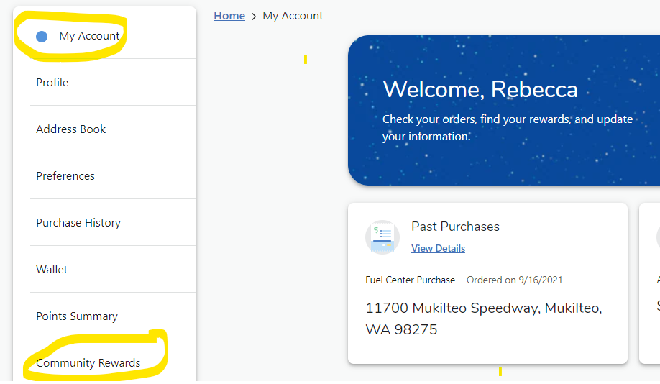
Passive Ways for Support
Welcome
Standing Rules/
Board Members & Chairs
Treasurer’s Report
Past Events
January Events
Skate Night & Movie Night
Passive Ways to Financially Support
Ways to be Involved
Remaining Events
Corporate Match
Box Tops
Fred Meyer Rewards

