Slide 1

February General
Membership Meeting
Columbia Elementary PTA
3:45pm Columbia Elementary Library
02/15/2024

Slide 2
Standing Rules
Welcome
Standing Rules/
Board Members & Committee Chairs
Treasurer’s Report
Past Events
February Events
Movie Night
Ways to be Involved
Remaining Events
Please see our website www.mycolumbiapta.org
BOARD MEMBERS
COMMITTEE CHAIRS
President: Jaime Lewis
Vice President: Rebecca Mork
VP– School Liaison: Ruba Alawar
Secretary: Tran Le
Treasurer: Laura Yengich / Patricia Bai
Art Docent/Poetry By Heart: Tran Le
Spiritwear: Kelly Engelbrecht
Book Fair: Chrissy Klosterman & Amanda Andrus
Reflections: Kristina Bowman
Food for Thought: Karen Siscel-Smith
Teacher Appreciation: Amanda Andrus & Patricia Bai
Popcorn Monday: Amanda Andrus

Slide 3
Welcome
Standing Rules/
Board Members & Committee Chairs
Treasurer’s Report
Past Events
February Events
Movie Night
Ways to be Involved
Remaining Events
POTENTIAL 2024-2025
BOARD MEMBERS
COMMITTEE CHAIRS
President: Jaime Lewis
Vice President: Patricia Bai
VP– School Liaison: Ruba Alawar
Secretary: Tran Le
Treasurer: __________/ Laura Yengich
Fundraising: ______________
Art Docent: _______________
Poetry By Heart: Tran Le
Spiritwear: Kelly Engelbrecht
Book Fair: Chrissy Klosterman & ______________
Reflections: Kristina Bowman?
Food for Thought: Karen Siscel-Smith?
Teacher Appreciation: Patricia Bai & Trang Phan
Popcorn Monday: Kelly Engelbrecht?

Slide 4
Treasurer’s Report:
Welcome
Standing Rules/
Board Members & Chairs
Treasurer’s Report
Past Events
February Events
Movie Night
Ways to be Involved
Remaining Events
Current Budget Update
Grants

Slide 5
Past Events updates:
Welcome
Standing Rules/
Board Members & Chairs
Treasurer’s Report
Past
Events
February Events
Movie Night
Ways to be Involved
Remaining Events
Still need to hand out popsicles for Read-A-Thon reward…waiting for better weather
Reflections Update
Kindness Week: any feedback?
Multi-Cultural Night:
  Feedback on Imagine Children’s Museum
  Thoughts for next year?

Slide 6
FEBRUARY events:
Welcome
Standing Rules/
Board Members & Chairs
Treasurer’s Report
Past Events
February
Events
Ways to be Involved
Movie Night
Remaining Events
Skate Night: Thursday, 2/29/2024 6pm – 8pm
  Angle of the Winds Arena (Everett)
  Registration is open
  Anything else we need to do?
Popcorn Monday: 2/26/2024
  We need a few more volunteers to help with this event

Slide 7
Movie night: 3/14/2024
Welcome
Standing Rules/
Board Members & Chairs
Treasurer’s Report
Past Events
February Events
Movie Night
Ways to be Involved
Remaining Events
Movie?
No cost for admission
Snacks for sale (popcorn for free again?)
See if we can get donated popcorn from AMC or Regal?

Slide 8
2024 Events:
Welcome
Standing Rules/
Board Members & Chairs
Treasurer’s Report
Remaining Events
Ways to be Involved
Past Events
February Events
Skate Night & Movie Night
February – May Art Docent
Dine Out Night (still trying to schedule one more Dine Out Night)
3/11 – 3/15 Support Professionals Appreciation Week
3/14/2024 Movie Night
3/21/2024 General Membership Meeting (7pm Zoom)
3/25/2024 Popcorn Monday

Slide 9
2024 Events:
Welcome
Standing Rules/
Board Members & Chairs
Treasurer’s Report
Remaining Events
Ways to be Involved
Past Events
February Events
Skate Night & Movie Night
4/18/2024 General Membership Meeting (3:45pm Library)
4/19/2024 Set up for Spring Book Fair
4/22 – 4/26/2024 Spring Book Fair
4/25/2024 Bingo Night
4/29/2024 Popcorn Monday
4/29 – 5/3/2024 Poetry By Heart
5/6 – 5/10/2024 Teacher Appreciation Week

Slide 10
2024 Events:
Welcome
Standing Rules/
Board Members & Chairs
Treasurer’s Report
Remaining Events
Ways to be Involved
Past Events
February Events
Skate Night & Movie Night
5/16/2024 General Membership Meeting (7pm Zoom) – Final Meeting of Year
5/17/2024 VIP & Me (5/24/2024 potential 2nd VIP & Me, if needed?)
5/20/2024 Popcorn Monday
5/31/2024 Beach Day
6/5 – 6/7/2024 5th Grade Camp (any update on needs from 5th grade team?)
6/17/2024 Final Popcorn Monday (or Popsicle Monday)
Schedule an After-School Gaga Ball Pit Party for 2023 graduates?

Slide 11

Please sign in on the sign-in sheet
Welcome
Standing Rules/
Board Members & Chairs
Treasurer’s Report
Past Events
February Events
Skate Night & Movie Night
Ways to be Involved
Remaining Events
Need Volunteers for:
Spring Book Fair (4/22 – 4/26/2024)
2024-2025 Board Treasurer
2024-2025 Fundraising Committee
2024-2025 Art Docent Chairperson
Next General Membership Meeting:
  Thursday, 3/21/2024 at 7pm (Zoom)
We will take what you can give. You can give what you want. There is a role for everyone.
You don’t have to be a PTA member to volunteer; remember to sign up as a volunteer thru MSD.

Slide 12
Agenda
Welcome
Standing Rules / Board Members / Committee Chairs
Treasurer’s Report
Past Events
January Events
Ways to be Involved
Skate Night & Movie Night
Remaining Events

Slide 13


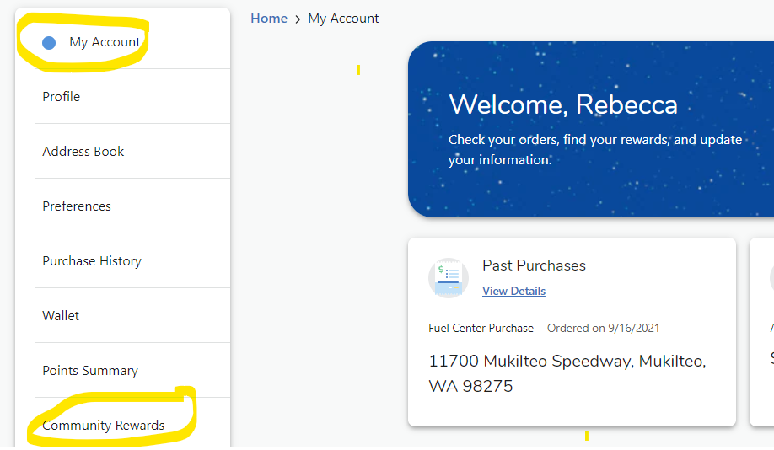
Passive Ways for Support
Welcome
Standing Rules/
Board Members & Chairs
Treasurer’s Report
Past Events
January Events
Skate Night & Movie Night
Passive Ways to Financially Support
Ways to be Involved
Remaining Events
Corporate Match
Box Tops
Fred Meyer Rewards

