Slide 1

April General
Membership Meeting
Columbia Elementary PTA
3:45PM in the Columbia Elementary Library
4/18/2024

Slide 2
Standing Rules
Welcome
Standing Rules/
Board Members & Committee Chairs
Treasurer’s Report
Past Events
Upcoming
Events
Spring Book Fair
Ways to be Involved
Remaining Events
Please see our website www.mycolumbiapta.org
BOARD MEMBERS
COMMITTEE CHAIRS
President: Jaime Lewis
Vice President: Rebecca Mork
VP– School Liaison: Ruba Alawar
Secretary: Tran Le
Treasurer: Laura Yengich / Patricia Bai
Art Docent/Poetry By Heart: Tran Le
Spiritwear: Kelly Engelbrecht
Book Fair: Chrissy Klosterman & Amanda Andrus
Reflections: Kristina Bowman
Food for Thought: Karen Siscel-Smith
Teacher Appreciation: Amanda Andrus & Patricia Bai
Popcorn Monday: Kelly Engelbrecht

Slide 3
Welcome
Standing Rules/
Board Members & Committee Chairs
Treasurer’s Report
Past Events
Upcoming
Events
Spring Book Fair
Ways to be Involved
Remaining Events
POTENTIAL 2024-2025
BOARD MEMBERS
COMMITTEE CHAIRS
President: Jaime Lewis
Vice President: Patricia Bai
VP– School Liaison: Ruba Alawar
Secretary: Tran Le
Treasurer: __________/ Laura Yengich
Fundraising: ______________
Art Docent: _______________
Poetry By Heart: Tran Le
Spiritwear: Kelly Engelbrecht
Book Fair: Chrissy Klosterman & Lesley Martinell
Reflections: Kristina Bowman?
Food for Thought: Karen Siscel-Smith?
Teacher Appreciation: Patricia Bai & Trang Phan
Popcorn Monday: Kelly Engelbrecht?

Slide 4
Treasurer’s Report:
Welcome
Standing Rules/
Board Members & Chairs
Treasurer’s Report
Past Events
Upcoming
Events
Spring Book Fair
Ways to be Involved
Remaining Events
Current Budget Update
Grants - Summary of Grants provided
2024-2025 Budget
  Vote to approve 2024-2025 budget

Slide 5
Past Events updates:
Welcome
Standing Rules/
Board Members & Chairs
Treasurer’s Report
Past
Events
Upcoming
Events
Spring Book Fair
Ways to be Involved
Remaining Events
Pajama Jam, STEAM Night, Multi-Cultural Night, Skate Night, Movie Night
Read-A-Thon fundraiser
Any feedback on past events?

Slide 6
UPCOMING events:
Welcome
Standing Rules/
Board Members & Chairs
Treasurer’s Report
Past Events
Upcoming
Events
Ways to be Involved
Spring Book Fair
Remaining Events
Bingo Night: 4/25/2024
  We need a few volunteers to help with concession sales
Poetry By Heart Contest: 5/1/2024 & 5/2/2024
  We’ll need a few judges on 5/1 & 5/2 (contest is during school hours)

Slide 7
Spring Book fair: april 22-26
Welcome
Standing Rules/
Board Members & Chairs
Treasurer’s Report
Past Events
Upcoming Events
Spring Book Fair
Ways to be Involved
Remaining Events
Set up on Friday, April 19th (~11:30-2:30)
We still need A LOT of volunteers!
Students will get the opportunity to shop the book fair during their library time as well as after school. Only books (and bookmarks) are available to purchase during library time.
Evening hours – Tuesday and Thursday
Thursday shopping coincides with Bingo Night (no over-lap)
Must be paid PTA member to run the cash register

Slide 8
2024 Events:
Welcome
Standing Rules/
Board Members & Chairs
Treasurer’s Report
Remaining Events
Ways to be Involved
Past Events
Upcoming
Events
Spring Book Fair
4/29/2024 Popcorn Monday
5/6 – 5/10/2024 Teacher Appreciation Week
5/16/2024 General Membership Meeting (7pm Zoom) – Final Meeting of Year
5/17/2024 VIP & Me
5/20/2024 Popcorn Monday
5/31/2024 Beach Day
6/5 – 6/7/2024 5th Grade Camp (any update on needs from 5th grade team?)
6/17/2024 Popsicle Monday

Slide 9

Please sign in on the sign-in sheet
Welcome
Standing Rules/
Board Members & Chairs
Treasurer’s Report
Past Events
Upcoming Events
Spring Book
Fair
Ways to be Involved
Remaining Events
Need Volunteers for:
2024-2025 Board Treasurer (or President)
2024-2025 Fundraising Committee
2024-2025 Art Docent Chairperson
Next General Membership Meeting:
  Thursday, 4/18/2024 at 3:45pm
We will take what you can give. You can give what you want. There is a role for everyone.
You don’t have to be a PTA member to volunteer; remember to sign up as a volunteer thru MSD.

Slide 10


Slide 11
Agenda
Welcome
Standing Rules / Board Members / Committee Chairs
Treasurer’s Report
Past Events
February Events
Ways to be Involved
Movie Night
Remaining Events

Slide 12


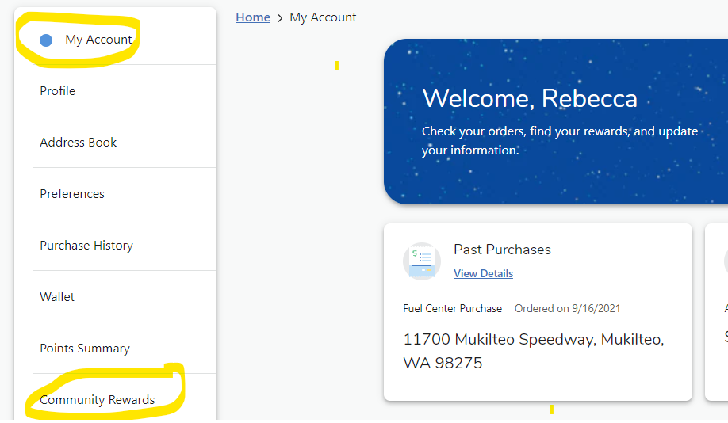
Passive Ways for Support
Welcome
Standing Rules/
Board Members & Chairs
Treasurer’s Report
Past Events
January Events
Skate Night & Movie Night
Passive Ways to Financially Support
Ways to be Involved
Remaining Events
Corporate Match
Box Tops
Fred Meyer Rewards

